Slide 1
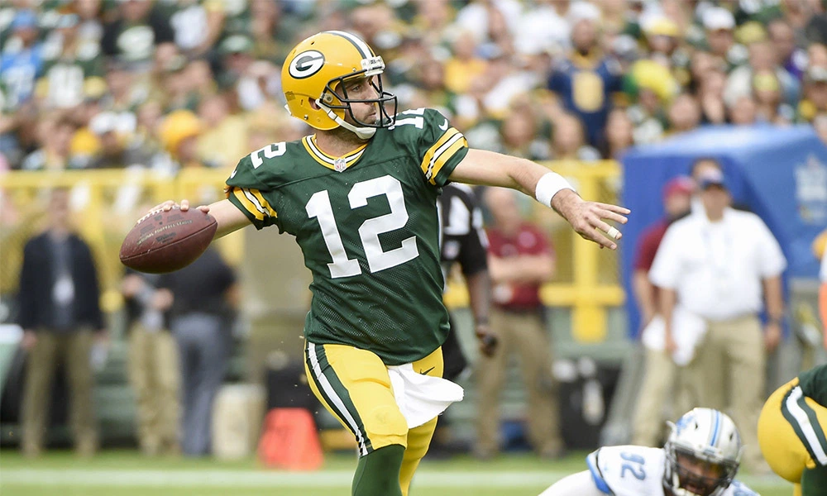
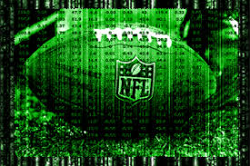
NFL Quarterback Stat Identifier
Keep track of your favorite Quarterbacks all season long with our
effortless and effective stat identifier application.
Developed by Nate Oberkofler & Sean Malloy

